Slide 1

Final Project Jake Catlett Southern New Hampshire University
DAT-490 Analytics Capstone
Lee Edwards
August 20, 2017

Slide 2
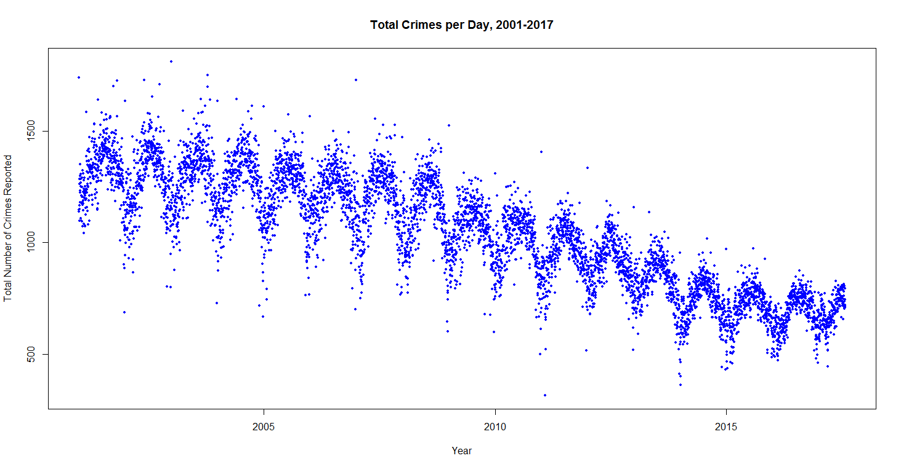
Patterns in Chicago Crime

Slide 3
Patterns in Chicago Crime
Seasonality
Overall trends
Possible distinct populations
The differences between these populations
Predictions for future trends

Slide 4
Data Source
Data sourced from City of Chicago
Crimes – 2001 to present; PoliceDistrict
Approximately 6.5 million observations
Accessible through API or through direct download
Variables chosen to show FBI Code, Domestic, Date, Police District,
X Coordinate, and Y Coordinate

Slide 5

Analytic Tools
R programming language used exclusively
R is freely available, open source
Powerful industry standard tool for top-to-bottom analytics
Strong reliance on Hadley Wickham’s ggmap, ggplot2, and dplyr packages
Packages used include maptools, mapproj, forecast

Slide 6
Discovery

Slide 7
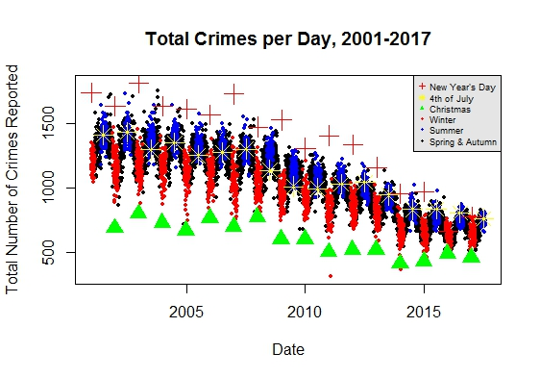
Discovery

Slide 8
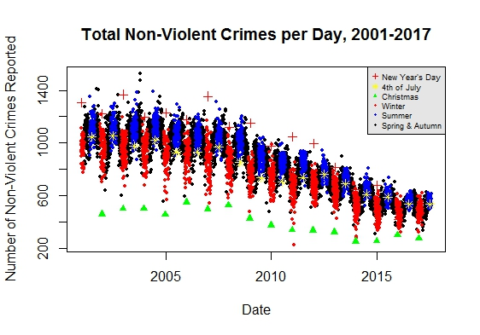
Discovery

Slide 9
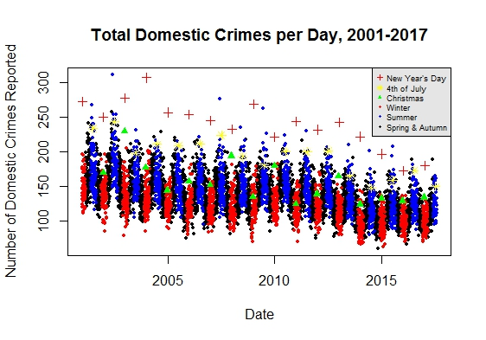
Discovery

Slide 10
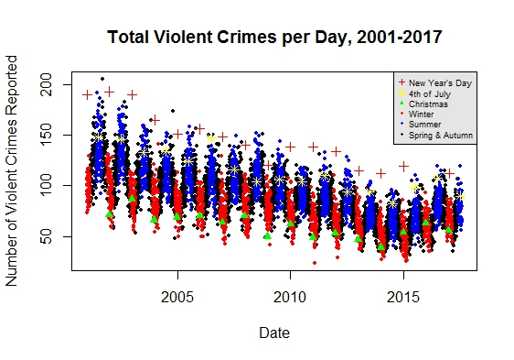
Discovery

Slide 11
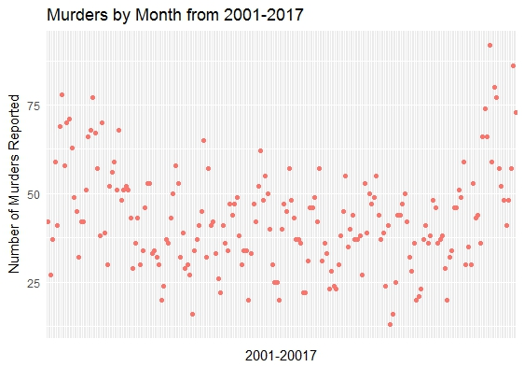
Discovery

Slide 12
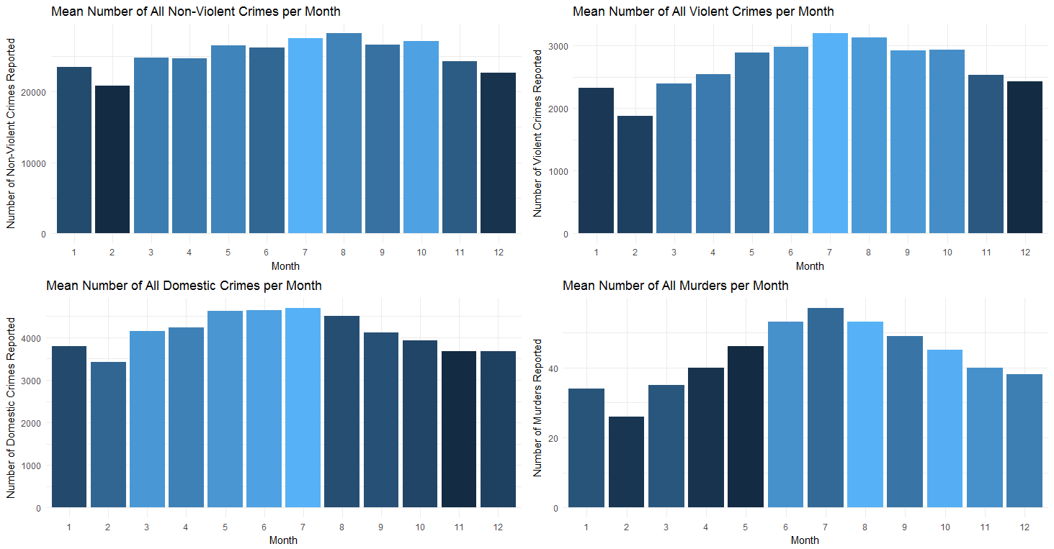
Distinct Populations
Notes:
Some of the R code used to subset and aggregate the data is included here
# Create a master data frame which all crimes committed per day in the dataset
#This data frame is used for all further subsetting going forward
#First all observations are included with only Date and X,Y coordinates included
crimes_total <- crimes_truncated %>%
select(Date, X.Coordinate, Y.Coordinate, Domestic, FBI.Code, District)
# Then columns are added to identify the season, month, and year
# in which each observation lies, enabling further aggregating and
# aiding in creation of visualizations
crimes_total$Date <- as.Date(crimes_total$Date, format="%m/%d/%Y")
crimes_total$Season <- as.factor(sapply(strftime(crimes_total$Date, "%m"), switch,
"12" = "winter",
"01" = "winter",
"02" = "winter",
"03" = "spring",
"04" = "spring",
"05" = "spring",
"06" = "summer",
"07" = "summer",
"08" = "summer",
"09" = "autumn",
"10" = "autumn",
"11" = "autumn"))
crimes_total$Month <- as.factor(sapply(strftime(crimes_total$Date, "%m"), switch,
"12" = "12",
"01" = "01",
"02" = "02",
"03" = "03",
"04" = "04",
"05" = "05",
"06" = "06",
"07" = "07",
"08" = "08",
"09" = "09",
"10" = "10",
"11" = "11"))
crimes_total$Year <- as.factor(sapply(strftime(crimes_total$Date, "%Y"), switch,
"2001" = "2001",
"2002" = "2002",
"2003" = "2003",
"2004" = "2004",
"2005" = "2005",
"2006" = "2006",
"2007" = "2007",
"2008" = "2008",
"2009" = "2009",
"2010" = "2010",
"2011" = "2011",
"2012" = "2012",
"2013" = "2013",
"2014" = "2014",
"2015" = "2015",
"2016" = "2016",
"2017" = "2017"))
####################################################################################
#Aggregate all crimes by the date on which they were committed
crimes_per_day <- crimes_total %>%
group_by(Date) %>%
summarise(no_rows = length(Date))
# Create a season column identify seasons and holidays
crimes_per_day$Season <- sapply(strftime(crimes_per_day$Date, "%m"), switch,
"12" = "winter",
"01" = "winter",
"02" = "winter",
"03" = "spring",
"04" = "spring",
"05" = "spring",
"06" = "summer",
"07" = "summer",
"08" = "summer",
"09" = "autumn",
"10" = "autumn",
"11" = "autumn")
# Modify the season column to identify New Year's Day, 4th of July, and Christmas, respectively
crimes_per_day$Season <- if_else(strftime(crimes_per_day$Date, "%m")=="01" &
strftime(crimes_per_day$Date, "%d")=="01",
"XNYD", crimes_per_day$Season)
crimes_per_day$Season <- if_else(strftime(crimes_per_day$Date, "%m")=="07" &
strftime(crimes_per_day$Date, "%d")=="04",
"XIND", crimes_per_day$Season)
crimes_per_day$Season <- if_else(strftime(crimes_per_day$Date, "%m")=="12" &
strftime(crimes_per_day$Date, "%d")=="25",
"XXMS", crimes_per_day$Season)
crimes_per_day$Season <- as.factor(crimes_per_day$Season)
#Create a data frame aggregating total crimes committed in each calendar month
crimes_total_YearMo <- crimes_total %>%
mutate(YearMo = format(Date, "%Y%m")) %>%
group_by(YearMo) %>%
summarise(no_rows = length(YearMo))
crimes_total_YearMo$YearMo <- as.factor(crimes_total_YearMo$YearMo)
crimes_total_YearMo$Year <- as.numeric(substr(crimes_total_YearMo$YearMo, 1, 4))
crimes_total_YearMo$Month <- as.numeric(substr(crimes_total_YearMo$YearMo, 5, 6))
crimes_monthly_summary <- as.data.frame(matrix(ncol=4, nrow=12))
colnames(crimes_monthly_summary) <- c("Month", "Total_Crime",
"Mean_Crime", "SD_Crime")
crimes_monthly_summary$Month <- as.numeric(crimes_monthly_summary$Month)
crimes_monthly_summary$Total_Crime <- as.numeric(crimes_monthly_summary$Total_Crime)
crimes_monthly_summary$Mean_Crime <- as.numeric(crimes_monthly_summary$Mean_Crime)
crimes_monthly_summary$SD_Crime <- as.numeric(crimes_monthly_summary$SD_Crime)
for(i in 1:12){
for(j in 1:4){
tempFrame <- filter(crimes_total_YearMo, Month==as.character(i))
switch(j,
crimes_monthly_summary[i, j] <- i,
crimes_monthly_summary[i, j] <- sum(as.numeric(tempFrame$no_rows)),
crimes_monthly_summary[i, j] <- round(mean(as.numeric(tempFrame$no_rows)), dig=0),
crimes_monthly_summary[i, j] <- round(sd(as.numeric(tempFrame$no_rows)), dig=1))
}
}
crimes_monthly_summary$Month <- as.factor(crimes_monthly_summary$Month)
#Create a data frame aggregating total crimes commited in each calendar year
crimes_per_year <- crimes_total %>%
filter(Year!=2017) %>%
group_by(Year) %>%
summarise(no_rows = length(Year))
#Create a data frame aggregating total crimes committed by
#the district in which they were committed
crimes_by_district <- as.data.frame(matrix(ncol=6, nrow=25))
colnames(crimes_by_district) <- c("District",
"numCrime",
"X.Coor.Ag",
"Y.Coor.Ag",
"X.Avg",
"Y.Avg")
crimes_by_district$District <- as.numeric(crimes_by_district$District)
crimes_by_district$numCrime <- as.numeric(crimes_by_district$numCrime)
crimes_by_district$X.Coor.Ag <- as.numeric(crimes_by_district$X.Coor.Ag)
crimes_by_district$Y.Coor.Ag <- as.numeric(crimes_by_district$Y.Coor.Ag)
crimes_by_district$X.Avg <- as.numeric(crimes_by_district$X.Avg)
crimes_by_district$Y.Avg <- as.numeric(crimes_by_district$Y.Avg)
for(i in 1:25){
for(j in 1:6){
tempFrame <- filter(crimes_total, District==i)
switch(j,
crimes_by_district[i, j] <- i,
crimes_by_district[i, j] <- nrow(tempFrame),
crimes_by_district[i, j] <- sum(as.numeric(tempFrame$X.Coordinate)),
crimes_by_district[i, j] <- sum(as.numeric(tempFrame$Y.Coordinate)),
crimes_by_district[i, j] <- sum(as.numeric(tempFrame$X.Coordinate))/nrow(tempFrame),
crimes_by_district[i, j] <- sum(as.numeric(tempFrame$Y.Coordinate))/nrow(tempFrame))
}
}
####################################################################################
#Create a subset of all non-violent crimes by including only non-domestic crimes and excluding
#those crimes which have an FBI Code that indicates a violent crime
nonV_crimes <- filter(crimes_total, Domestic=="false")
nonV_crimes <- filter(nonV_crimes, FBI.Code != "01A")
nonV_crimes <- filter(nonV_crimes, FBI.Code != "02")
nonV_crimes <- filter(nonV_crimes, FBI.Code != "03")
nonV_crimes <- filter(nonV_crimes, FBI.Code != "04A")
nonV_crimes <- filter(nonV_crimes, FBI.Code != "04B")
#Aggregate all non-violent crimes by the date on which they were committed
nonV_crimes_per_day <- nonV_crimes %>%
group_by(Date) %>%
summarise(no_rows = length(Date))
#Create a column to identify the season in which a non-violent crime was committed
nonV_crimes_per_day$Season <- sapply(strftime(nonV_crimes_per_day$Date, "%m"), switch,
"12" = "winter",
"01" = "winter",
"02" = "winter",
"03" = "spring",
"04" = "spring",
"05" = "spring",
"06" = "summer",
"07" = "summer",
"08" = "summer",
"09" = "autumn",
"10" = "autumn",
"11" = "autumn")
# Modify the season column to identify holidays
nonV_crimes_per_day$Season <- if_else(strftime(nonV_crimes_per_day$Date, "%m")=="01" &
strftime(nonV_crimes_per_day$Date, "%d")=="01",
"XNYD", nonV_crimes_per_day$Season)
nonV_crimes_per_day$Season <- if_else(strftime(nonV_crimes_per_day$Date, "%m")=="07" &
strftime(nonV_crimes_per_day$Date, "%d")=="04",
"XIND", nonV_crimes_per_day$Season)
nonV_crimes_per_day$Season <- if_else(strftime(nonV_crimes_per_day$Date, "%m")=="12" &
strftime(nonV_crimes_per_day$Date, "%d")=="25",
"XXMS", nonV_crimes_per_day$Season)
nonV_crimes_per_day$Season <- as.factor(nonV_crimes_per_day$Season)
#Create a data frame aggregating total non-violent crimes committed in each calendar month
nonV_crimes_YearMo <- nonV_crimes %>%
mutate(YearMo = format(Date, "%Y%m")) %>%
group_by(YearMo) %>%
summarise(no_rows = length(YearMo))
nonV_crimes_YearMo$YearMo <- as.factor(nonV_crimes_YearMo$YearMo)
nonV_crimes_YearMo$Year <- as.numeric(substr(nonV_crimes_YearMo$YearMo, 1, 4))
nonV_crimes_YearMo$Month <- as.numeric(substr(nonV_crimes_YearMo$YearMo, 5, 6))
nonV_crimes_monthly_summary <- as.data.frame(matrix(ncol=4, nrow=12))
colnames(nonV_crimes_monthly_summary) <- c("Month", "Total_nonV",
"Mean_nonV", "SD_nonV")
nonV_crimes_monthly_summary$Month <- as.numeric(nonV_crimes_monthly_summary$Month)
nonV_crimes_monthly_summary$Total_nonV <- as.numeric(nonV_crimes_monthly_summary$Total_nonV)
nonV_crimes_monthly_summary$Mean_nonV <- as.numeric(nonV_crimes_monthly_summary$Mean_nonV)
nonV_crimes_monthly_summary$SD_nonV <- as.numeric(nonV_crimes_monthly_summary$SD_nonV)
for(i in 1:12){
for(j in 1:4){
tempFrame <- filter(nonV_crimes_YearMo, Month==as.character(i))
switch(j,
nonV_crimes_monthly_summary[i, j] <- i,
nonV_crimes_monthly_summary[i, j] <- sum(as.numeric(tempFrame$no_rows)),
nonV_crimes_monthly_summary[i, j] <- round(mean(as.numeric(tempFrame$no_rows)), dig=0),
nonV_crimes_monthly_summary[i, j] <- round(sd(as.numeric(tempFrame$no_rows)), dig=1))
}
}
nonV_crimes_monthly_summary$Month <- as.factor(nonV_crimes_monthly_summary$Month)
#Create a data frame aggregating total non-violent crimes commited in each calendar year
nonV_crimes_per_year <- nonV_crimes %>%
filter(Year!=2017) %>%
group_by(Year) %>%
summarise(no_rows = length(Year))
#Create a data frame aggregating total non-violent crimes committed by
#the district in which they were committed
nonV_crimes_by_district <- as.data.frame(matrix(ncol=6, nrow=25))
colnames(nonV_crimes_by_district) <- c("District",
"numNonV",
"X.Coor.Ag",
"Y.Coor.Ag",
"X.Avg",
"Y.Avg")
nonV_crimes_by_district$District <- as.numeric(nonV_crimes_by_district$District)
nonV_crimes_by_district$numNonV <- as.numeric(nonV_crimes_by_district$numNonV)
nonV_crimes_by_district$X.Coor.Ag <- as.numeric(nonV_crimes_by_district$X.Coor.Ag)
nonV_crimes_by_district$Y.Coor.Ag <- as.numeric(nonV_crimes_by_district$Y.Coor.Ag)
nonV_crimes_by_district$X.Avg <- as.numeric(nonV_crimes_by_district$X.Avg)
nonV_crimes_by_district$Y.Avg <- as.numeric(nonV_crimes_by_district$Y.Avg)
for(i in 1:25){
for(j in 1:6){
tempFrame <- filter(nonV_crimes, District==i)
switch(j,
nonV_crimes_by_district[i, j] <- i,
nonV_crimes_by_district[i, j] <- nrow(tempFrame),
nonV_crimes_by_district[i, j] <- sum(as.numeric(tempFrame$X.Coordinate)),
nonV_crimes_by_district[i, j] <- sum(as.numeric(tempFrame$Y.Coordinate)),
nonV_crimes_by_district[i, j] <- sum(as.numeric(tempFrame$X.Coordinate))/nrow(tempFrame),
nonV_crimes_by_district[i, j] <- sum(as.numeric(tempFrame$Y.Coordinate))/nrow(tempFrame))
}
}
####################################################################################
#Create a subset of all domestic crimes
dom_crimes <- crimes_total %>%
filter(Domestic=="true")
#Aggregate total domestic crimes by the date on which they were committed
dom_crimes_per_day <- dom_crimes %>%
group_by(Date) %>%
summarise(no_rows = length(Date))
#Create a column to identify which season in which a crime was committed
dom_crimes_per_day$Season <- sapply(strftime(dom_crimes_per_day$Date, "%m"), switch,
"12" = "winter",
"01" = "winter",
"02" = "winter",
"03" = "spring",
"04" = "spring",
"05" = "spring",
"06" = "summer",
"07" = "summer",
"08" = "summer",
"09" = "autumn",
"10" = "autumn",
"11" = "autumn")
#Modify the season column to identify New Year's Day, 4th of July, and Christmas, respectively
dom_crimes_per_day$Season <- if_else(strftime(dom_crimes_per_day$Date, "%m")=="01" &
strftime(dom_crimes_per_day$Date, "%d")=="01",
"XNYD", dom_crimes_per_day$Season)
dom_crimes_per_day$Season <- if_else(strftime(dom_crimes_per_day$Date, "%m")=="07" &
strftime(dom_crimes_per_day$Date, "%d")=="04",
"XIND", dom_crimes_per_day$Season)
dom_crimes_per_day$Season <- if_else(strftime(dom_crimes_per_day$Date, "%m")=="12" &
strftime(dom_crimes_per_day$Date, "%d")=="25",
"XXMS", dom_crimes_per_day$Season)
dom_crimes_per_day$Season <- as.factor(dom_crimes_per_day$Season)
#Create a data frame aggregating total domestic crimes committed in each calendar month
dom_crimes_YearMo <- dom_crimes %>%
mutate(YearMo = format(Date, "%Y%m")) %>%
group_by(YearMo) %>%
summarise(no_rows = length(YearMo))
dom_crimes_YearMo$YearMo <- as.factor(dom_crimes_YearMo$YearMo)
dom_crimes_YearMo$Year <- as.numeric(substr(dom_crimes_YearMo$YearMo, 1, 4))
dom_crimes_YearMo$Month <- as.numeric(substr(dom_crimes_YearMo$YearMo, 5, 6))
dom_crimes_monthly_summary <- as.data.frame(matrix(ncol=4, nrow=12))
colnames(dom_crimes_monthly_summary) <- c("Month", "Total_Domestic",
"Mean_Domestic", "SD_Domestic")
dom_crimes_monthly_summary$Month <- as.numeric(dom_crimes_monthly_summary$Month)
dom_crimes_monthly_summary$Total_Domestic <- as.numeric(dom_crimes_monthly_summary$Total_Domestic)
dom_crimes_monthly_summary$Mean_Domestic <- as.numeric(dom_crimes_monthly_summary$Mean_Domestic)
dom_crimes_monthly_summary$SD_Domestic <- as.numeric(dom_crimes_monthly_summary$SD_Domestic)
for(i in 1:12){
for(j in 1:4){
tempFrame <- filter(dom_crimes_YearMo, Month==as.character(i))
switch(j,
dom_crimes_monthly_summary[i, j] <- i,
dom_crimes_monthly_summary[i, j] <- sum(as.numeric(tempFrame$no_rows)),
dom_crimes_monthly_summary[i, j] <- round(mean(as.numeric(tempFrame$no_rows)), dig=0),
dom_crimes_monthly_summary[i, j] <- round(sd(as.numeric(tempFrame$no_rows)), dig=1))
}
}
dom_crimes_monthly_summary$Month <- as.factor(dom_crimes_monthly_summary$Month)
#Create a data frame aggregating total domestic crimes commited in each calendar year
dom_crimes_per_year <- dom_crimes %>%
filter(Year!=2017) %>%
group_by(Year) %>%
summarise(no_rows = length(Year))
#Create a data frame aggregating total domestic crimes committed by
#the district in which they were committed
dom_crimes_by_district <- as.data.frame(matrix(ncol=6, nrow=25))
colnames(dom_crimes_by_district) <- c("District",
"numDomestic",
"X.Coor.Ag",
"Y.Coor.Ag",
"X.Avg",
"Y.Avg")
dom_crimes_by_district$District <- as.numeric(dom_crimes_by_district$District)
dom_crimes_by_district$numDomestic <- as.numeric(dom_crimes_by_district$numDomestic)
dom_crimes_by_district$X.Coor.Ag <- as.numeric(dom_crimes_by_district$X.Coor.Ag)
dom_crimes_by_district$Y.Coor.Ag <- as.numeric(dom_crimes_by_district$Y.Coor.Ag)
dom_crimes_by_district$X.Avg <- as.numeric(dom_crimes_by_district$X.Avg)
dom_crimes_by_district$Y.Avg <- as.numeric(dom_crimes_by_district$Y.Avg)
for(i in 1:25){
for(j in 1:6){
tempFrame <- filter(dom_crimes, District==i)
switch(j,
dom_crimes_by_district[i, j] <- i,
dom_crimes_by_district[i, j] <- nrow(tempFrame),
dom_crimes_by_district[i, j] <- sum(as.numeric(tempFrame$X.Coordinate)),
dom_crimes_by_district[i, j] <- sum(as.numeric(tempFrame$Y.Coordinate)),
dom_crimes_by_district[i, j] <- sum(as.numeric(tempFrame$X.Coordinate))/nrow(tempFrame),
dom_crimes_by_district[i, j] <- sum(as.numeric(tempFrame$Y.Coordinate))/nrow(tempFrame))
}
}
####################################################################################
#Create a subset of all violent crimes, not including murder, as identified by their FBI Code
v_crimes <- crimes_total %>%
filter(FBI.Code == "02" |
FBI.Code == "03" |
FBI.Code == "04A"|
FBI.Code == "04B")
#Aggregate violent crimes by the date on which they were committed
v_crimes_per_day <- v_crimes %>%
group_by(Date) %>%
summarise(no_rows = length(Date))
#Create a column which identifies which season in which a crime was committed
v_crimes_per_day$Season <- sapply(strftime(v_crimes_per_day$Date, "%m"), switch,
"12" = "winter",
"01" = "winter",
"02" = "winter",
"03" = "spring",
"04" = "spring",
"05" = "spring",
"06" = "summer",
"07" = "summer",
"08" = "summer",
"09" = "autumn",
"10" = "autumn",
"11" = "autumn")
# Modify the season column to identify New Year's Day, 4th of July, and Christmas, respectively
v_crimes_per_day$Season <- if_else(strftime(v_crimes_per_day$Date, "%m")=="01" &
strftime(v_crimes_per_day$Date, "%d")=="01",
"XNYD", v_crimes_per_day$Season)
v_crimes_per_day$Season <- if_else(strftime(v_crimes_per_day$Date, "%m")=="07" &
strftime(v_crimes_per_day$Date, "%d")=="04",
"XIND", v_crimes_per_day$Season)
v_crimes_per_day$Season <- if_else(strftime(v_crimes_per_day$Date, "%m")=="12" &
strftime(v_crimes_per_day$Date, "%d")=="25",
"XXMS", v_crimes_per_day$Season)
v_crimes_per_day$Season <- as.factor(dom_crimes_per_day$Season)
#Create a data frame aggregating total violent crimes committed in each calendar month
v_crimes_YearMo <- v_crimes %>%
mutate(YearMo = format(Date, "%Y%m")) %>%
group_by(YearMo) %>%
summarise(no_rows = length(YearMo))
v_crimes_YearMo$YearMo <- as.factor(v_crimes_YearMo$YearMo)
v_crimes_YearMo$Year <- as.numeric(substr(v_crimes_YearMo$YearMo, 1, 4))
v_crimes_YearMo$Month <- as.numeric(substr(v_crimes_YearMo$YearMo, 5, 6))
v_crimes_monthly_summary <- as.data.frame(matrix(ncol=4, nrow=12))
colnames(v_crimes_monthly_summary) <- c("Month", "Total_Violent",
"Mean_Violent", "SD_Violent")
v_crimes_monthly_summary$Month <- as.numeric(v_crimes_monthly_summary$Month)
v_crimes_monthly_summary$Total_Violent <- as.numeric(v_crimes_monthly_summary$Total_Violent)
v_crimes_monthly_summary$Mean_Violent <- as.numeric(v_crimes_monthly_summary$Mean_Violent)
v_crimes_monthly_summary$SD_Violent <- as.numeric(v_crimes_monthly_summary$SD_Violent)
for(i in 1:12){
for(j in 1:4){
tempFrame <- filter(v_crimes_YearMo, Month==as.character(i))
switch(j,
v_crimes_monthly_summary[i, j] <- i,
v_crimes_monthly_summary[i, j] <- sum(as.numeric(tempFrame$no_rows)),
v_crimes_monthly_summary[i, j] <- round(mean(as.numeric(tempFrame$no_rows)), dig=0),
v_crimes_monthly_summary[i, j] <- round(sd(as.numeric(tempFrame$no_rows)), dig=1))
}
}
v_crimes_monthly_summary$Month <- as.factor(v_crimes_monthly_summary$Month)
#Create a data frame aggregating total violent crimes commited in each calendar year
v_crimes_per_year <- v_crimes %>%
filter(Year!=2017) %>%
group_by(Year) %>%
summarise(no_rows = length(Year))
#Create a data frame aggregating total non-violent crimes committed by
#the district in which they were committed
v_crimes_by_district <- as.data.frame(matrix(ncol=6, nrow=25))
colnames(v_crimes_by_district) <- c("District",
"numViolent",
"X.Coor.Ag",
"Y.Coor.Ag",
"X.Avg",
"Y.Avg")
v_crimes_by_district$District <- as.numeric(v_crimes_by_district$District)
v_crimes_by_district$numViolent <- as.numeric(v_crimes_by_district$numViolent)
v_crimes_by_district$X.Coor.Ag <- as.numeric(v_crimes_by_district$X.Coor.Ag)
v_crimes_by_district$Y.Coor.Ag <- as.numeric(v_crimes_by_district$Y.Coor.Ag)
v_crimes_by_district$X.Avg <- as.numeric(v_crimes_by_district$X.Avg)
v_crimes_by_district$Y.Avg <- as.numeric(v_crimes_by_district$Y.Avg)
for(i in 1:25){
for(j in 1:6){
tempFrame <- filter(v_crimes, District==i)
switch(j,
v_crimes_by_district[i, j] <- i,
v_crimes_by_district[i, j] <- nrow(tempFrame),
v_crimes_by_district[i, j] <- sum(as.numeric(tempFrame$X.Coordinate)),
v_crimes_by_district[i, j] <- sum(as.numeric(tempFrame$Y.Coordinate)),
v_crimes_by_district[i, j] <- sum(as.numeric(tempFrame$X.Coordinate))/nrow(tempFrame),
v_crimes_by_district[i, j] <- sum(as.numeric(tempFrame$Y.Coordinate))/nrow(tempFrame))
}
}
####################################################################################
#Create a subset of all murders
murder <- crimes_total %>%
filter(FBI.Code == "01A")
#Create a data frame aggregating total murders committed in each calendar month
#Create a data frame aggregating total violent crimes committed in each calendar month
murder_YearMo <- murder %>%
mutate(YearMo = format(Date, "%Y%m")) %>%
group_by(YearMo) %>%
summarise(no_rows = length(YearMo))
murder_YearMo$YearMo <- as.factor(murder_YearMo$YearMo)
murder_YearMo$Year <- as.numeric(substr(murder_YearMo$YearMo, 1, 4))
murder_YearMo$Month <- as.numeric(substr(murder_YearMo$YearMo, 5, 6))
murder_monthly_summary <- as.data.frame(matrix(ncol=4, nrow=12))
colnames(murder_monthly_summary) <- c("Month", "Total_Murder",
"Mean_Murder", "SD_Murder")
murder_monthly_summary$Month <- as.numeric(murder_monthly_summary$Month)
murder_monthly_summary$Total_Murder <- as.numeric(murder_monthly_summary$Total_Murder)
murder_monthly_summary$Mean_Murder <- as.numeric(murder_monthly_summary$Mean_Murder)
murder_monthly_summary$SD_Murder <- as.numeric(murder_monthly_summary$SD_Murder)
for(i in 1:12){
for(j in 1:4){
tempFrame <- filter(murder_YearMo, Month==as.character(i))
switch(j,
murder_monthly_summary[i, j] <- i,
murder_monthly_summary[i, j] <- sum(as.numeric(tempFrame$no_rows)),
murder_monthly_summary[i, j] <- round(mean(as.numeric(tempFrame$no_rows)),dig=0),
murder_monthly_summary[i, j] <- round(sd(as.numeric(tempFrame$no_rows)), dig=1))
}
}
murder_monthly_summary$Month <- as.factor(murder_monthly_summary$Month)
#Create a data frame aggregating total murders commited in each calendar year
murder_per_year <- murder %>%
filter(Year!=2017) %>%
group_by(Year) %>%
summarise(no_rows = length(Year))
#Create a data frame aggregating total murders committed by district in which they were committed
murder_by_district <- as.data.frame(matrix(ncol=6, nrow=25))
colnames(murder_by_district) <- c("District",
"numMurder",
"X.Coor.Ag",
"Y.Coor.Ag",
"X.Avg",
"Y.Avg")
murder_by_district$District <- as.numeric(murder_by_district$District)
murder_by_district$numMurder <- as.numeric(murder_by_district$numMurder)
murder_by_district$X.Coor.Ag <- as.numeric(murder_by_district$X.Coor.Ag)
murder_by_district$Y.Coor.Ag <- as.numeric(murder_by_district$Y.Coor.Ag)
murder_by_district$X.Avg <- as.numeric(murder_by_district$X.Avg)
murder_by_district$Y.Avg <- as.numeric(murder_by_district$Y.Avg)
for(i in 1:25){
for(j in 1:6){
tempFrame <- filter(murder, District==i)
switch(j,
murder_by_district[i, j] <- i,
murder_by_district[i, j] <- nrow(tempFrame),
murder_by_district[i, j] <- sum(as.numeric(tempFrame$X.Coordinate)),
murder_by_district[i, j] <- sum(as.numeric(tempFrame$Y.Coordinate)),
murder_by_district[i, j] <- sum(as.numeric(tempFrame$X.Coordinate))/nrow(tempFrame),
murder_by_district[i, j] <- sum(as.numeric(tempFrame$Y.Coordinate))/nrow(tempFrame))
}
}

Slide 13
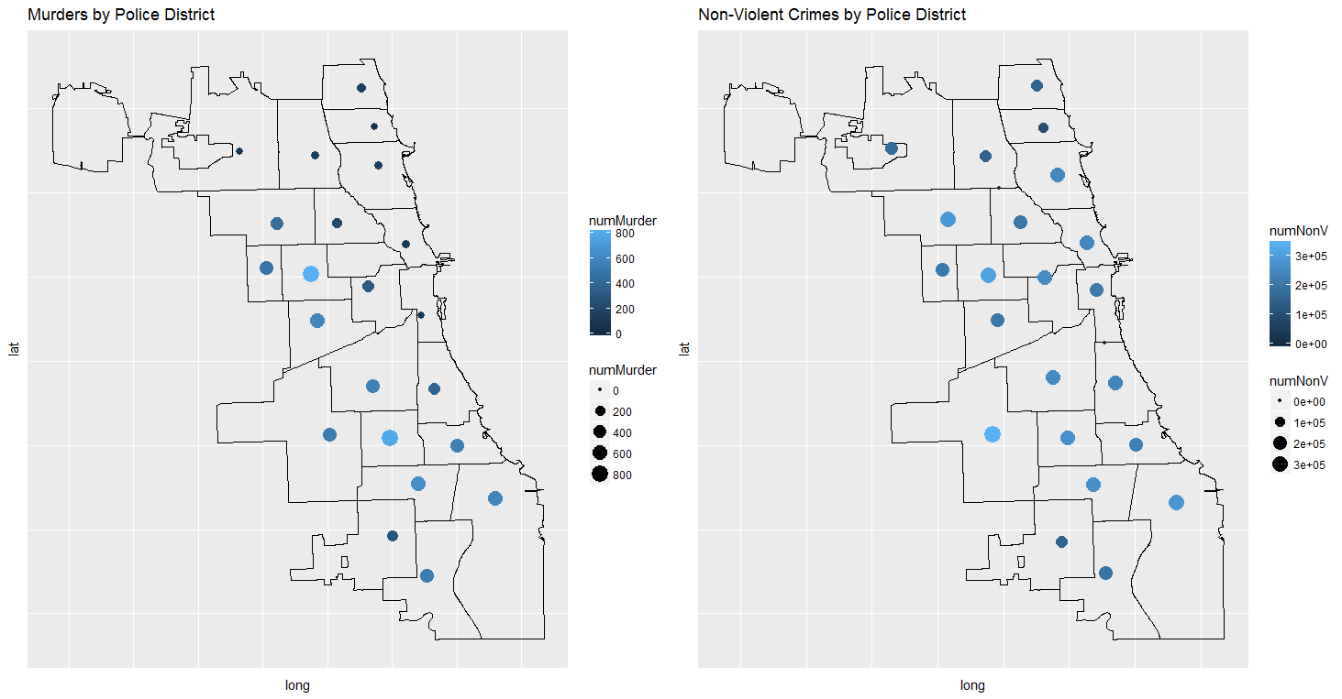
Distinct Populations
Notes:
Some of the R code used to generate visualizations for this analysis is included here
library(ggplot2)
library(ggmap)
library(mapproj)
library(maptools)
library(DT)
chicago <- readShapePoly("PoliceDistrict")
chicago <- fortify(chicago)
## Initial plot to show overall crime trend and seasonality
plot(y=crimes_per_day$no_rows,
x=crimes_per_day$Date,
main = "Total Crimes per Day, 2001-2017",
xlab = "Year",
ylab = "Total Number of Crimes Reported",
pch = 20,
cex = .75,
col = "blue")
#Plots to show means and sd for overall crimes
CrimeMean_Plot <- ggplot(data=crimes_monthly_summary, aes(x=Month, y=Mean_Crime)) +
geom_bar(stat="identity", aes(fill=crimes_monthly_summary$SD_Crime)) +
theme_minimal() +
theme(legend.position = "none") +
labs(title="Mean Number of All Crimes per Month",
x="Month", y="Number of Crimes Reported")
CrimeSD_Plot <- ggplot(data=crimes_monthly_summary, aes(x=Month, y=SD_Crime)) +
geom_bar(stat="identity", color="black", fill="lightgreen") +
theme_minimal() +
labs(title="Standard Deviation All Crimes per Month",
x="Month", y="Number of Crimes Reported")
#Create a map plot which shows relative frequency of crime by district in Chicago
CrimesDistrict_Plot<- ggplot(chicago) +
geom_path(aes(x=long, y=lat, group=group)) +
geom_point(data=crimes_by_district, aes(x=X.Avg,
y=Y.Avg,
colour=numCrime,
size=numCrime)) +
labs(title="Total Crimes by Police District") +
theme(
axis.text.x=element_blank(),
axis.text.y=element_blank(),
axis.ticks=element_blank())
# order crimes_per_day alphabetically on season column
# this is done so that when points are plotted the holidays are plotted last, and therefore
# stand out on the chart instead of getting plotted over by other points
crimes_per_day <- arrange(crimes_per_day, Season)
# crimes_per_day plotted, highlighting seasonality and three key holidays
plot(y=crimes_per_day$no_rows,
x=crimes_per_day$Date,
main = "Total Crimes per Day, 2001-2017",
xlab = "Date",
ylab = "Total Number of Crimes Reported",
pch = if_else(crimes_per_day$Season=="XNYD", 3,
if_else(crimes_per_day$Season=="XIND", 8,
if_else(crimes_per_day$Season=="XXMS", 17,
20))),
cex = if_else(crimes_per_day$Season=="XNYD" |
crimes_per_day$Season=="XIND" |
crimes_per_day$Season=="XXMS", 2,
.75),
col = if_else(crimes_per_day$Season=="XNYD", "red",
if_else(crimes_per_day$Season=="XIND", "yellow",
if_else(crimes_per_day$Season=="XXMS", "green",
if_else(crimes_per_day$Season=="winter", "red",
if_else(crimes_per_day$Season=="summer", "blue",
"black"))))))
legend("topright",
legend=c("New Year's Day", "4th of July", "Christmas", "Winter", "Summer", "Spring & Autumn"),
pch=c(3, 8, 17, 20, 20, 20),
cex=c(.585),
col=c("red", "yellow", "green", "red", "blue", "black"),
bg="gray90")
############################################################################################
nonV_Mean_Plot <- ggplot(data=nonV_crimes_monthly_summary, aes(x=Month, y=Mean_nonV)) +
geom_bar(stat="identity", aes(fill=nonV_crimes_monthly_summary$SD_nonV)) +
theme_minimal() +
theme(legend.position = "none") +
labs(title="Mean Number of All Non-Violent Crimes per Month",
x="Month", y="Number of Non-Violent Crimes Reported")
nonV_SD_Plot <- ggplot(data=nonV_crimes_monthly_summary, aes(x=Month, y=SD_nonV)) +
geom_bar(stat="identity", color="black", fill="lightgreen") +
theme_minimal() +
labs(title="Standard Deviation All Crimes per Month",
x="Month", y="Number of Non-Violent Crimes Reported")
nonV_District_Plot<- ggplot(chicago) +
geom_path(aes(x=long, y=lat, group=group)) +
geom_point(data=nonV_crimes_by_district, aes(x=X.Avg,
y=Y.Avg,
colour=numNonV,
size=numNonV)) +
labs(title="Non-Violent Crimes by Police District") +
theme(
axis.text.x=element_blank(),
axis.text.y=element_blank(),
axis.ticks=element_blank())
# order nonV_crimes_per_day alphabetically on Season column
# this is done so that when points are plotted the holidays are plotted last, and therefore
# stand out on the chart instead of getting plotted over by other points
nonV_crimes_per_day <- arrange(nonV_crimes_per_day, Season)
plot(y=nonV_crimes_per_day$no_rows,
x=nonV_crimes_per_day$Date,
main = "Total Non-Violent Crimes per Day, 2001-2017",
xlab = "Date",
ylab = "Number of Non-Violent Crimes Reported",
pch = if_else(nonV_crimes_per_day$Season=="XNYD", 3,
if_else(nonV_crimes_per_day$Season=="XIND", 8,
if_else(nonV_crimes_per_day$Season=="XXMS", 17,
20))),
cex = if_else(nonV_crimes_per_day$Season=="XNYD" |
nonV_crimes_per_day$Season=="XIND" |
nonV_crimes_per_day$Season=="XXMS", 1,
.75),
col = if_else(nonV_crimes_per_day$Season=="XNYD", "red",
if_else(nonV_crimes_per_day$Season=="XIND", "yellow",
if_else(nonV_crimes_per_day$Season=="XXMS", "green",
if_else(nonV_crimes_per_day$Season=="winter", "red",
if_else(nonV_crimes_per_day$Season=="summer", "blue",
"black"))))))
legend("topright",
legend=c("New Year's Day", "4th of July", "Christmas", "Winter", "Summer", "Spring & Autumn"),
pch=c(3, 8, 17, 20, 20, 20),
cex=c(.585),
col=c("red", "yellow", "green", "red", "blue", "black"),
bg="gray90")
#####################################################################
DomesticMean_Plot <- ggplot(data=dom_crimes_monthly_summary, aes(x=Month, y=Mean_Domestic)) +
geom_bar(stat="identity", aes(fill=dom_crimes_monthly_summary$SD_Domestic)) +
theme_minimal() +
theme(legend.position = "none") +
labs(title="Mean Number of All Domestic Crimes per Month",
x="Month", y="Number of Domestic Crimes Reported")
DomesticSD_Plot <- ggplot(data=dom_crimes_monthly_summary, aes(x=Month, y=SD_Domestic)) +
geom_bar(stat="identity", color="black", fill="lightgreen") +
theme_minimal() +
labs(title="Standard Deviation All Domestic Crimes per Month",
x="Month", y="Number of Domestic Crimes Reported")
DomesticDistrict_Plot<- ggplot(chicago) +
geom_path(aes(x=long, y=lat, group=group)) +
geom_point(data=dom_crimes_by_district, aes(x=X.Avg,
y=Y.Avg,
colour=numDomestic,
size=numDomestic)) +
labs(title="Domestic Crimes by Police District") +
theme(
axis.text.x=element_blank(),
axis.text.y=element_blank(),
axis.ticks=element_blank())
# order dom_crimes_per_day alphabetically on Season column
# this is done so that when points are plotted the holidays are plotted last, and therefore
# stand out on the chart instead of getting plotted over by other points
dom_crimes_per_day <- arrange(dom_crimes_per_day, Season)
# dom_crimes_per_day plotted, highlighting seasonality and three key holidays
plot(y=dom_crimes_per_day$no_rows,
x=dom_crimes_per_day$Date,
main = "Total Domestic Crimes per Day, 2001-2017",
xlab = "Date",
ylab = "Number of Domestic Crimes Reported",
pch = if_else(dom_crimes_per_day$Season=="XNYD", 3,
if_else(dom_crimes_per_day$Season=="XIND", 8,
if_else(dom_crimes_per_day$Season=="XXMS", 17,
20))),
cex = if_else(dom_crimes_per_day$Season=="XNYD" |
dom_crimes_per_day$Season=="XIND" |
dom_crimes_per_day$Season=="XXMS", 1,
.75),
col = if_else(dom_crimes_per_day$Season=="XNYD", "red",
if_else(dom_crimes_per_day$Season=="XIND", "yellow",
if_else(dom_crimes_per_day$Season=="XXMS", "green",
if_else(dom_crimes_per_day$Season=="winter", "red",
if_else(dom_crimes_per_day$Season=="summer", "blue",
"black"))))))
legend("topright",
legend=c("New Year's Day", "4th of July", "Christmas", "Winter", "Summer", "Spring & Autumn"),
pch=c(3, 8, 17, 20, 20, 20),
cex=c(.585),
col=c("red", "yellow", "green", "red", "blue", "black"),
bg="gray90")
##################################################################################
ViolentMean_Plot <- ggplot(data=v_crimes_monthly_summary, aes(x=Month, y=Mean_Violent)) +
geom_bar(stat="identity", aes(fill=v_crimes_monthly_summary$SD_Violent)) +
theme_minimal() +
theme(legend.position = "none") +
labs(title="Mean Number of All Violent Crimes per Month",
x="Month", y="Number of Violent Crimes Reported")
ViolentSD_Plot <- ggplot(data=v_crimes_monthly_summary, aes(x=Month, y=SD_Violent)) +
geom_bar(stat="identity", color="black", fill="lightgreen") +
theme_minimal() +
labs(title="Standard Deviation All Violent Crimes per Month",
x="Month", y="Number of Violent Crimes Reported")
ViolentDistrict_Plot<- ggplot(chicago) +
geom_path(aes(x=long, y=lat, group=group)) +
geom_point(data=v_crimes_by_district, aes(x=X.Avg,
y=Y.Avg,
colour=numViolent,
size=numViolent)) +
labs(title="Violent Crimes by Police District") +
theme(
axis.text.x=element_blank(),
axis.text.y=element_blank(),
axis.ticks=element_blank())
# order v_crimes_per_day alphabetically on season column
# this is done so that when points are plotted the holidays are plotted last, and therefore
# stand out on the chart instead of getting plotted over by other points
v_crimes_per_day <- arrange(v_crimes_per_day, Season)
# v_crimes_per_day plotted, highlighting seasonality and three key holidays
plot(y=v_crimes_per_day$no_rows,
x=v_crimes_per_day$Date,
main = "Total Violent Crimes per Day, 2001-2017",
xlab = "Date",
ylab = "Number of Violent Crimes Reported",
pch = if_else(v_crimes_per_day$Season=="XNYD", 3,
if_else(v_crimes_per_day$Season=="XIND", 8,
if_else(v_crimes_per_day$Season=="XXMS", 17,
20))),
cex = if_else(v_crimes_per_day$Season=="XNYD" |
v_crimes_per_day$Season=="XIND" |
v_crimes_per_day$Season=="XXMS", 1,
.75),
col = if_else(v_crimes_per_day$Season=="XNYD", "red",
if_else(v_crimes_per_day$Season=="XIND", "yellow",
if_else(v_crimes_per_day$Season=="XXMS", "green",
if_else(v_crimes_per_day$Season=="winter", "red",
if_else(v_crimes_per_day$Season=="summer", "blue",
"black"))))))
legend("topright",
legend=c("New Year's Day", "4th of July", "Christmas", "Winter", "Summer", "Spring & Autumn"),
pch=c(3, 8, 17, 20, 20, 20),
cex=c(.585),
col=c("red", "yellow", "green", "red", "blue", "black"),
bg="gray90")
###########################################################################
MurderDistrict_Plot <- ggplot(chicago) +
geom_path(aes(x=long, y=lat, group=group)) +
geom_point(data=murder_by_district, aes(x=X.Avg,
y=Y.Avg,
colour=numMurder,
size=numMurder)) +
labs(title="Murders by Police District") +
theme(
axis.text.x=element_blank(),
axis.text.y=element_blank(),
axis.ticks=element_blank())
MurderPlot <- ggplot(murder_YearMo, aes(x=YearMo, y=no_rows, colour="red", show.legend=FALSE)) +
geom_point() +
ggtitle("Murders by Month from 2001-2017") +
labs(y="Number of Murders Reported", x="2001-20017") +
theme(
axis.text.x=element_blank(),
axis.ticks=element_blank(),
legend.position = "none")
MurderMean_Plot <- ggplot(data=murder_monthly_summary, aes(x=Month, y=Mean_Murder)) +
geom_bar(stat="identity", aes(fill=murder_monthly_summary$SD_Murder)) +
theme_minimal() +
theme(legend.position = "none") +
labs(title="Mean Number of All Murders per Month",
x="Month", y="Number of Murders Reported")
MurderSD_Plot <- ggplot(data=murder_monthly_summary, aes(x=Month, y=SD_Murder)) +
geom_bar(stat="identity", color="black", fill="lightgreen") +
theme_minimal() +
labs(title="Standard Deviation All Murders per Month",
x="Month", y="Number of Murders Reported")

Slide 14
Model Building
Searched for distinct population with clustering - unsuccessful
Evidence of seasonality suggests using time series models
Models fitted and validated
Results analyzed for utility
Notes:
Sample R code for building models, testing for seasonality and trends, and validating results is included below
library(forecast)
#Forecasts and plots for total crimes
my_series <- ts(crimes_total_YearMo$no_rows,
start=c(2001, 12),
end=c(2017, 7),
frequency = 12)
seasonal_series <- stl(my_series, s.window="period")
plot(seasonal_series, xlab="Total")
plot(aggregate(my_series, FUN=mean), xlab="Total")
boxplot(my_series~cycle(my_series), xlab="Total")
adf.test(diff(log(my_series)),
alternative = "stationary",
k=0)
acf(diff(log(my_series)))
pacf(diff(log(my_series)))
fit <- arima(log(my_series), c(2, 1, 1),seasonal = list(order = c(2, 1, 1), period = 12))
predictions <- predict(fit, n.ahead = 5*12)
ts.plot(my_series, 2.718^predictions$pred, log="y", lty=c(1,3), xlab="Total")
#######################################################################3
#Forecasts and plots for non-violent crimes
my_series <- ts(nonV_crimes_YearMo$no_rows,
start=c(2001, 12),
end=c(2017, 7),
frequency = 12)
seasonal_series <- stl(my_series, s.window="period")
plot(seasonal_series, xlab="Non-Violent")
plot(aggregate(my_series, FUN=mean), xlab="Non-Violent")
boxplot(my_series~cycle(my_series), xlab="Non-Violent", main="Non-Violent Crimes per Month")
adf.test(diff(log(my_series)),
alternative = "stationary",
k=0)
acf(diff(log(my_series)))
pacf(diff(log(my_series)))
fit <- arima(log(my_series), c(2, 1, 1),seasonal = list(order = c(2, 1, 1), period = 12))
predictions <- predict(fit, n.ahead = 5*12)
ts.plot(my_series, 2.718^predictions$pred, log="y", lty=c(1,3), xlab="Non-Violent",
main="Historical and Predicted \n Trends For Non-Violent Crime", col="blue")
#######################################################################3
#Forecasts and plots for domestic crimes
my_series <- ts(dom_crimes_YearMo$no_rows,
start=c(2001, 12),
end=c(2017, 7),
frequency = 12)
seasonal_series <- stl(my_series, s.window="period")
plot(seasonal_series, xlab="Domestic")
plot(aggregate(my_series, FUN=mean), xlab="Domestic")
boxplot(my_series~cycle(my_series), xlab="Domestic", main="Domestic Crimes per Month")
adf.test(diff(log(my_series)),
alternative = "stationary",
k=0)
acf(diff(log(my_series)))
pacf(diff(log(my_series)))
fit <- arima(log(my_series), c(2, 1, 1),seasonal = list(order = c(2, 1, 1), period = 12))
predictions <- predict(fit, n.ahead = 5*12)
ts.plot(my_series, 2.718^predictions$pred, log="y", lty=c(1,3), xlab="Domestic",
main="Historical and Predicted \n Trends For Domestic Crime", col="blue")
#######################################################################3
#Forecasts and plots for violent crimes
my_series <- ts(v_crimes_YearMo$no_rows,
start=c(2001, 12),
end=c(2017, 7),
frequency = 12)
seasonal_series <- stl(my_series, s.window="period")
plot(seasonal_series, xlab="Violent")
plot(aggregate(my_series, FUN=mean), xlab="Violent")
boxplot(my_series~cycle(my_series), xlab="Violent", main="Violent Crimes per Month")
adf.test(diff(log(my_series)),
alternative = "stationary",
k=0)
acf(diff(log(my_series)))
pacf(diff(log(my_series)))
fit <- arima(log(my_series), c(2, 1, 1),seasonal = list(order = c(2, 1, 1), period = 12))
predictions <- predict(fit, n.ahead = 5*12)
ts.plot(my_series, 2.718^predictions$pred, log="y", lty=c(1,3),
xlab="Violent", main="Historical and Predicted \n Trends For Violent Crime", col="blue")
#######################################################################3
#Forecasts and plots for murders
my_series <- ts(murder_YearMo$no_rows,
start=c(2001, 12),
end=c(2017, 7),
frequency = 12)
seasonal_series <- stl(my_series, s.window="period")
plot(seasonal_series, xlab="Murder")
plot(aggregate(my_series, FUN=mean), xlab="Murder")
boxplot(my_series~cycle(my_series), xlab="Murder", main="Murders per Month")
adf.test(diff(log(my_series)),
alternative = "stationary",
k=0)
acf(diff(log(my_series)))
pacf(diff(log(my_series)))
fit <- arima(log(my_series), c(2, 1, 1),seasonal = list(order = c(2, 1, 1), period = 12))
predictions <- predict(fit, n.ahead = 5*12)
ts.plot(my_series, 2.718^predictions$pred, log="y", lty=c(1,3),
xlab="Murder", main="Historical and Predicted \n Trends For Murder", col="blue")
test_crimes <- crimes_per_day_monthly[1:nTest,]
validate_crimes <- crimes_per_day_monthly[132:199, ]
test_series <- ts(test_crimes$no_crimes,
start=c(2001, 12),
end=c(2011, 11),
frequency = 12)
test_fit <- arima(log(test_series), c(0, 1, 1),seasonal = list(order = c(0, 1, 1), period = 12))
predictions <- predict(test_fit, n.ahead = 68)
E_test <- validate_crimes$no_crimes - 2.718^predictions$pred
E_test <- as.data.frame(E_test)
colnames(E_test) <- c("errors")
E_test$sqrErrors <- E_test$errors^2
RMSE <- sqrt(sum(E_test$sqrErrors) / nrow(E_test))

Slide 15
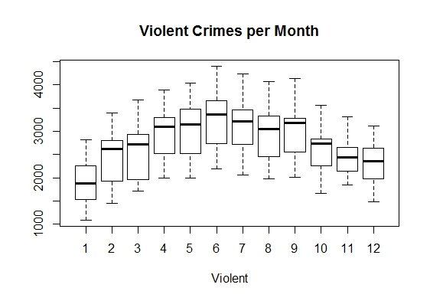
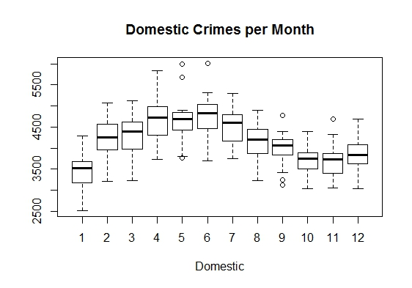
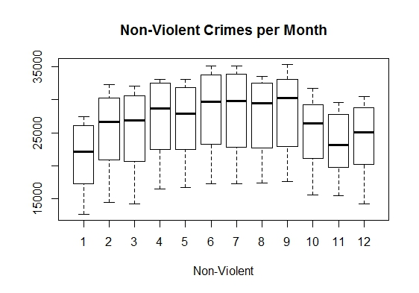
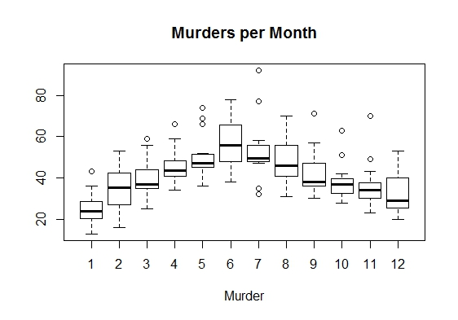
Model Building

Slide 16
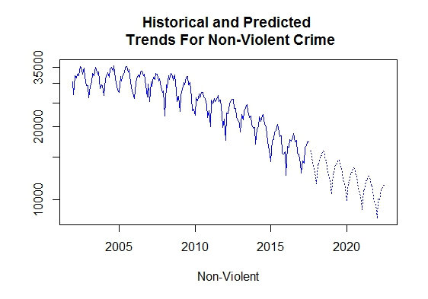
Model Results

Slide 17
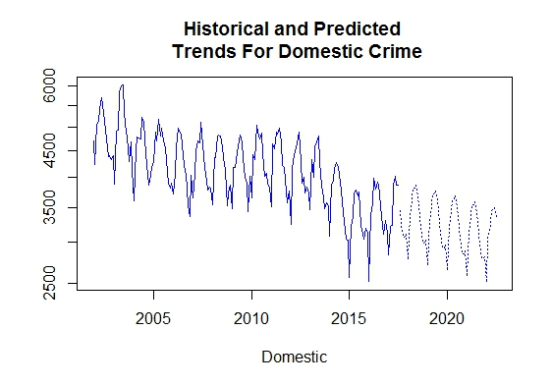
Model Results

Slide 18
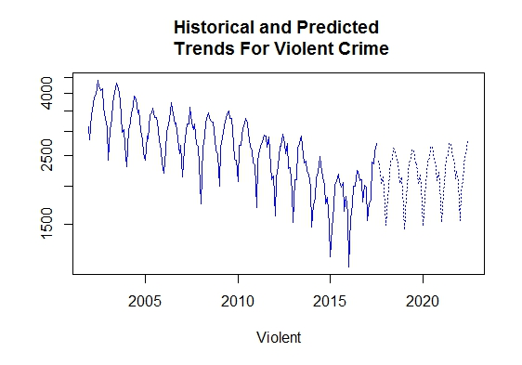
Model Results

Slide 19
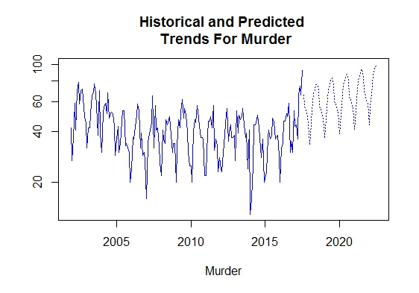
Model Results

Slide 20
Summary
Four possibly distinct populations discovered
Confirmation that seasonality impacts all populations
Violent crimes are geographically concentrated
Non-Violent crime comparatively more evenly distributed

Slide 21
Summary
Domestic crime less impacted by seasonality
Violent crime surges on New Year’s
Overall crime is very low on Xmas
Domestic crime spikes on holidays like Xmas and New Year’s

Slide 22
Recommendations
Follow-up, prove rigorously populations are distinct
Continue exploring to search for other populations
Enrich data by including socio-economic factors
Begin search for variables correlated to crime
Test other model types for other insights
Regularly update models and test against predictions

